Slide 1
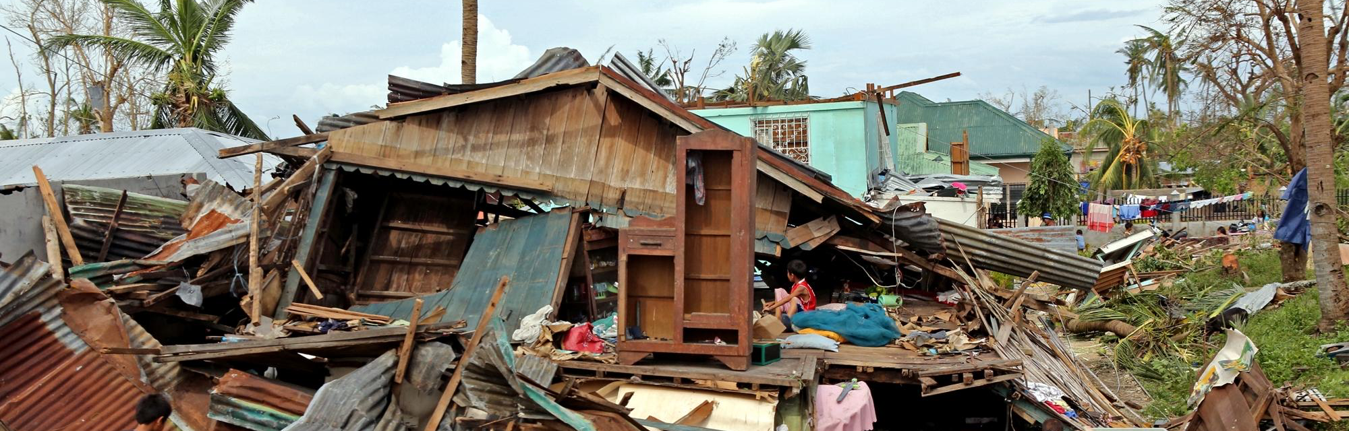
FILIET: An Information Extraction System
for Disaster-Related Tweets
Kyle Mc Hale B. Dela Cruz
Email: kyle_delacruz@dlsu.edu.ph
John Paul F. Garcia
Email: john_paul_garcia@dlsu.edu.ph
Kristine Ma. Dominique F. Kalaw
Email: kristine_kalaw@dlsu.edu.ph
Vilson E. Lu
Email: vilson_lu@dlsu.edu.ph

Slide 2
Outline of the
PRESENTATION

Slide 3
Outline of the Presentation
1
Overview of the Current State of Technology
2
Review of Existing Related Works
3
Research Methodology
4
Research Experiments
5
Discussion and Future Works

Slide 4
Overview of the Current State of
TECHNOLOGY

Slide 5
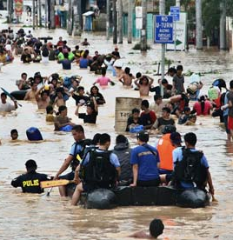

Overview of the Current State of Technology
1
“about 2 million people died and an estimate of US$ 1.7 trillion of damage were sustained in disasters…”
Notes:
UN’s office for disaster management
Year 2000-2012
Encouragement for research → social media

Slide 6

Overview of the Current State of Technology
1
The
Philippines
is considered as the
Social Media Capital of the World.
Notes:
Online apps/platforms that aim in interaction, collaboration, and sharing of content
Recent study and analysis… philippines

Slide 7

Overview of the Current State of Technology
1
Twitter, a popular microblogging platform where users can post statuses in real-time, is used to share information regarding the disaster as well as response efforts.
Notes:
- Vastly used to share disaster related info

Slide 8

Overview of the Current State of Technology
1
The PH government has released an official newsletter indicating the official social media accounts and unified hashtags to help in the disaster relief effort.

Slide 9
Overview of the Current State of Technology
1
THE MAIN CHALLENGE
To build an information extraction (IE) system for disaster-related Twitter content which is written in the Filipino language (with respect to the TXTSPK and code-switching writing styles).
Notes:
- Filipino Information Extraction Tool for Twitter or FILIET

Slide 10
Review of Existing
RELATED WORKS

Slide 11
Review of Existing Related Works
2
GENERAL IE SYSTEMS FOR DISASTER-RELATED TWEETS
EXTRACTING INFORMATION NUGGETS FROM
DISASTER-RELATED MESSAGES IN SOCIAL MEDIA
PRACTICAL EXTRACTION OF DISASTER-RELEVANT INFORMATION FROM SOCIAL MEDIA
Imran, Elbassuoni, Castillo, Diaz, & Meier (2013)
Imran, Elbassuoni, Castillo, Diaz, & Meier (2013)

Slide 12
Review of Existing Related Works
2
MACHINE LEARNING-BASED IE SYSTEMS
MACHINE LEARNING FOR INFORMATION EXTRACTION IN INFORMAL DOMAINS
A MACHINE LEARNING APPROACH TO INFORMATION EXTRACTION
LEARNING IE RULES FOR A SET OF RELATED CONCEPTS
Freitag (2000)
Téllez, Montes-y-Gómez, & Villaseñor-Pineda (2005)
Turmo & Rodriguez (2000)

Slide 13
Review of Existing Related Works
2
RULE-BASED IE SYSTEMS
BUSINESS SPECIFIC ONLINE INFORMATION EXTRACTION FROM GERMAN WEBSITES
INFORMATION EXTRACTION FOR VIETNAMESE REAL ESTATE ADVERTISEMENTS
Lee & Geierhos (2009)
Pham, L. & Pham, S. (2012)

Slide 14
Review of Existing Related Works
2
TEMPLATE-BASED & ONTOLOGY-BASED IE SYSTEMS
AN OPEN ARCHITECTURE FOR MULTI-DOMAIN INFORMATION EXTRACTION
ONTOLOGY-BASED INFORMATION EXTRACTION FOR FRENCH NEWSPAPER ARTICLES
Poibeau (2014)
Nebhi (2012)

Slide 15
Review of Existing Related Works
2
ADAPTIVE IE SYSTEMS
ADAPTIVE INFORMATION EXTRACTION
SOCIAL MEDIA MONITORING FOR DISASTERS
Turmo, Ageno & Català (2006)
Cheng, Chua, Co & Magpantay (2012)

Slide 16
Research
METHODOLOGY

Slide 17
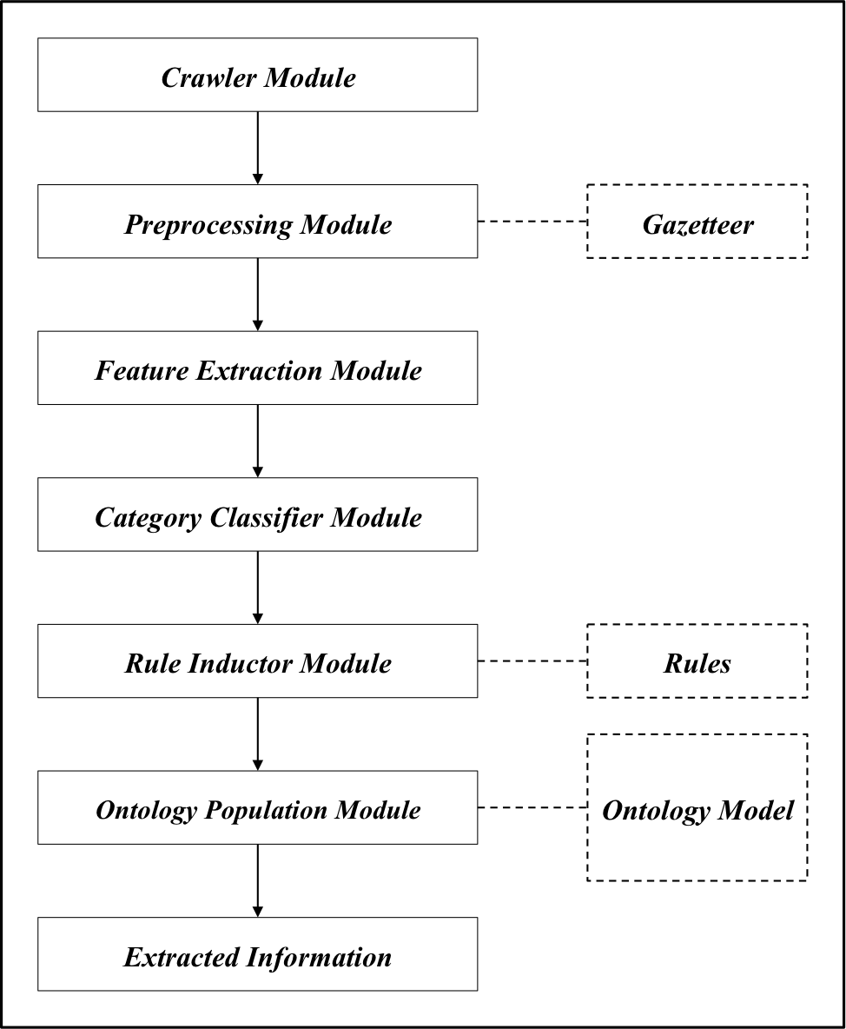
Research Methodology
3
ARCHITECTURAL DESIGN OF THE FILIET SYSTEM

Slide 18
CRAWLER MODULE
3
The crawler module is for retrieving and collecting tweets using Twitter’s Stream API and the Twitter4j library.
<tweet>
Kailangan na talaga ng military efforts sa most part of Leyte. Nagkakagulo na. ☹
</tweet>

Slide 19
PREPROCESSING MODULE
3
TEXT NORMALIZER
This sub-module handles the conversion of TXTSPK words to its full-word format as well as the removal of emoticons, links, and hashtags for the uniformity and consistency of the extracted information.
<tweet>
Kailangan na talaga ng military efforts sa most part of Leyte. Nagkakagulo na.
</tweet>

Slide 20
PREPROCESSING MODULE
3
TOKENIZER
This sub-module will split the input into individual tokens which will be used for the subsequent sub-modules.
<tweet>
"Kailangan", "na", "talaga", "ng", "military", "efforts", "sa", "most", "part", "of", "Leyte", ".", "Nagkakagulo", "na", "."
</tweet>

Slide 21
PREPROCESSING MODULE
3
POS TAGGER
This sub-module will tag each of the tokens with its corresponding part-of-speech. A tokens can be tagged as a noun, a verb, an adjective, an adverb, or other part-of-speech tags.
<tweet>
"Kailangan_VOTF", "na_NA", "talaga_IRIA", "ng_NA", "military_NCOM", "efforts_NNS", "sa_NCOM", "most_JJS", "part_JJ", "of_IN", "Leyte_NPRO", "._PSNS", "Nagkakagulo", "na_NA", "._PSNS”
</tweet>

Slide 22
PREPROCESSING MODULE
3
FILIPINO NER
This sub-module is responsible for identifying and tagging the proper nouns in the input. The proper nouns are identified with the use of a gazetteer.
<tweet>
"Kailangan_VOTF", "na_NA", "talaga_IRIA", "ng_NA", "military_NCOM", "efforts_NNS", "sa_NCOM", "most_JJS", "part_JJ", "of_IN", "<location: Leyte/>", "._PSNS", "Nagkakagulo", "na_NA" "._PSNS"
</tweet>

Slide 23
FEATURE EXTRACTION MODULE
3
PRESENCE
This is a binary feature that indicates the presence of keywords like disaster words, mentions, hashtags, emoticons, retweets, and if code switching has occurred in the input tweet. The value of “1” is given if the keyword is present, else it is given “0”.
TWEET LENGTH
This feature essentially counts the length of the input tweet.

Slide 24
FEATURE EXTRACTION MODULE
3
N-GRAM
This is mainly responsible for generating/extracting the different n-grams for the input tweets, specifically, the bi-gram and the tri-gram of the input tweets.
USER
This will help in determining the type of disaster. For example, @dost_pagasa will tweet about typhoons.

Slide 25
FEATURE EXTRACTION MODULE
3
LOCATION
This feature are the locations mentioned in the tweet.

Slide 26
CATEGORY CLASSIFIER MODULE
3
With the extracted features and Weka as the tool, the category classifier module will classify the tweets into one of the following categories:
CAUTION AND ADVICE
CASUALTY AND DAMAGE
DONATION
OTHERS

Slide 27
RULE INDUCTOR MODULE
3
The rule inductor module applies the set of rules by looking for patterns in the text.
<string: naman>
<disaster>
<string:sa> AS Disaster
<POS: NNS>
<location>
<POS: PSNS>AS Location

Slide 28
ONTOLOGY POPULATION MODULE
3
The ontology population module handles the filling up of the ontology with instances. This module will receive the instances in I. For each instance in I, it will look for the matching class for it. If it found a match, the instance will be added to the ontology

Slide 29
Research Methodology
3
ARCHITECTURAL DESIGN OF THE FILIET SYSTEM

Slide 30
Research
EXPERIMENTS

Slide 31
Research Experiments
4
EXPERIMENTAL CORPUS
The first corpus is the combined corpus. All
of the categories are present in this corpus. It contains 2817 instances: 553 CA, 92 CD, 39 D, and 2133 O. This is used for the first experiment. The next 3 corpus are those that only contained two categories each, which is used for the second experiment.

Slide 32
Research Experiments
4
EXPERIMENTAL CORPUS
This is used for the first experiment. The next 3 corpus are those that only contained two categories each, which is used for the second experiment. For CA corpus, it contains 1028 instances: 567 CA and
461 O. For the CD corpus, it contains 123 instances: 72 CD and 51 O. For the D corpus, it contains 199 instances: 45 D and 145 O.

Slide 33
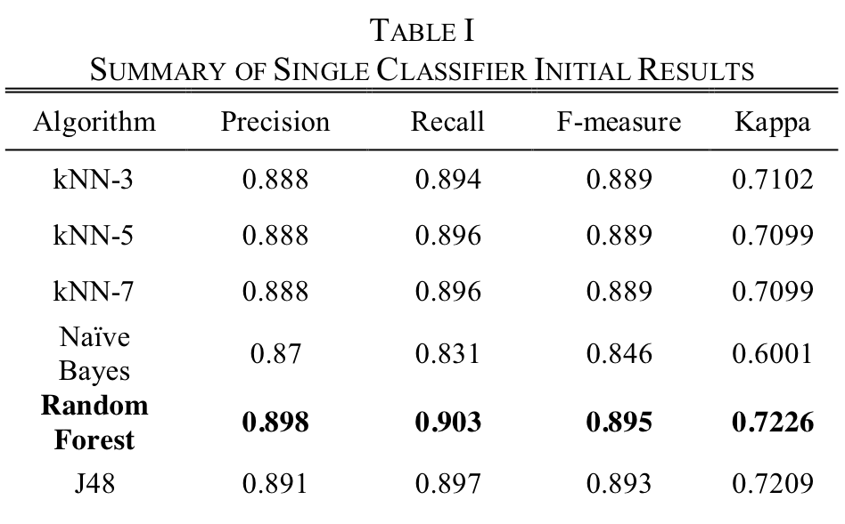
Research Experiments
4
EXPERIMENT 1: SINGLE CLASSIFIER

Slide 34
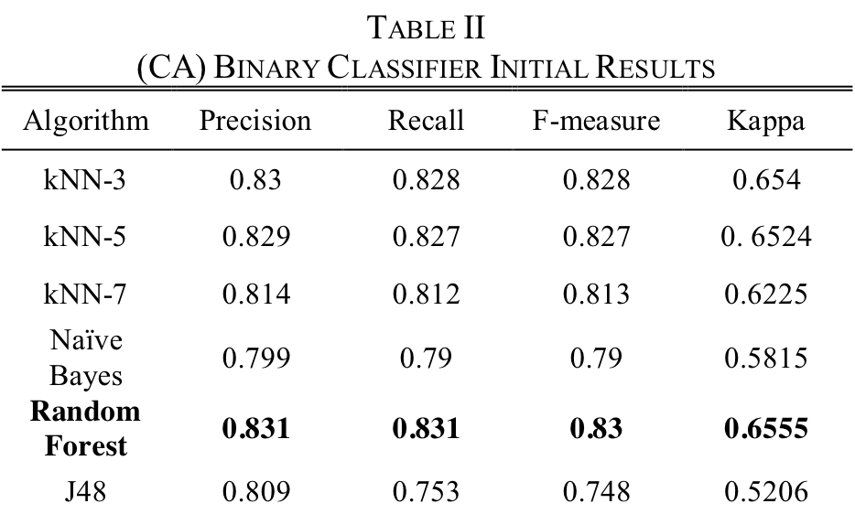
Research Experiments
4
EXPERIMENT 2: MULTIPLE BINARY CLASSIFIER (CA)

Slide 35
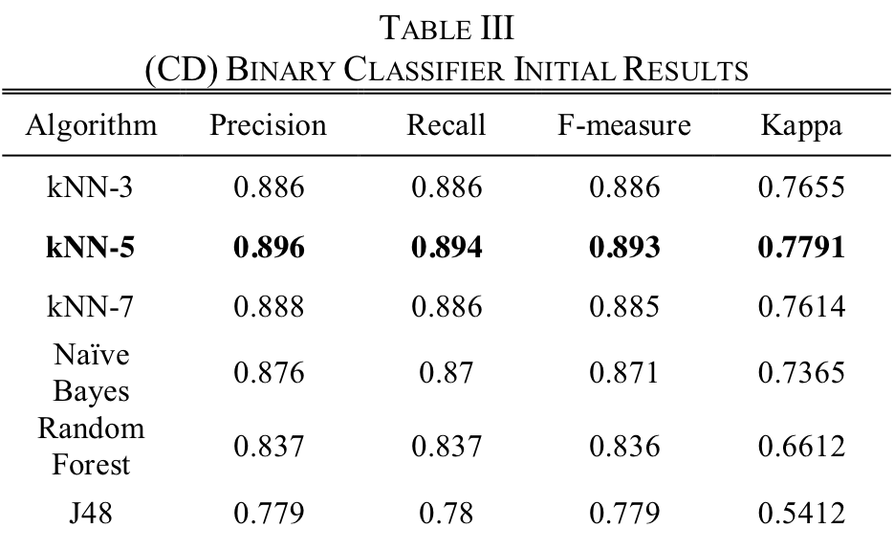
Research Experiments
4
EXPERIMENT 2: MULTIPLE BINARY CLASSIFIER (CD)

Slide 36
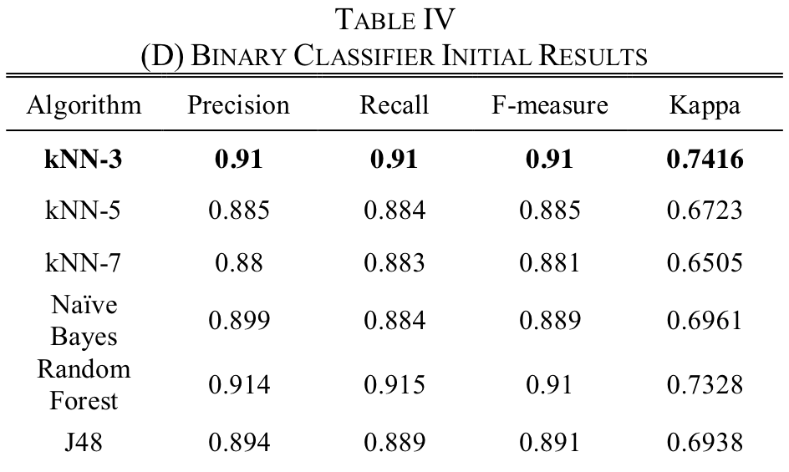
Research Experiments
4
EXPERIMENT 2: MULTIPLE BINARY CLASSIFIER (D)

Slide 37
Discussion and Future
WORKS

Slide 38
Discussion and Future Works
5
DISCUSSION OF THE RESEARCH
In this research, we attempt to apply an adaptive information extraction architecture that extracts the information from disaster-related Filipino tweets and displays them in an ontology.

Slide 39
Discussion and Future Works
5
FUTURE WORKS FOR THE RESEARCH
At present, the system is still being developed. It is important to increase the instances in the corpus so that there will be better results for future testing.

Slide 40
THANK YOU FOR
LISTENING!

